Slide 1
SECURE DATA HIDING IN IMAGES USING STEGANOGRAPHY
CAPSTONE PROJECT
Presented By:
Student Name : LAVANYA DUDDUKURI
College Name & Department : SRKR ENGINEERING COLLEGE (CSD)

Slide 2
OUTLINE
Problem Statement
Technology used
Wow factor
End users
Result
Conclusion
Git-hub Link
Future scope

Slide 3
Problem Statement
The problem of stenography revolves around the challenge of efficiently transcribing spoken language into written form using shorthand techniques. Stenographers must quickly capture speech, maintaining accuracy while keeping up with fast-paced conversations or dictations. The core issue lies in the need to develop a system that minimizes errors, improves transcription speed, and ensures clarity in the final output. Additionally, stenography systems must be adaptable to different speakers, accents, and contexts to ensure consistent quality in a variety of environments, from courtroom proceedings to business meetings.

Slide 4
Technology used
VSCode
Libraries
OpenCV
Bitwise Operations:
Data Encoding/Decoding
Password-Based Authentication
System Commands:
pip install opencv-python
pip install os-sys
pip install tkintertable

Slide 5
Wow factors
This project stands out due to its combination of bitwise encoding in image pixels for stealthy message hiding, password protection for added security, and an interactive user experience that automatically opens the encrypted image. It ensures efficient use of image size, handles real-time encoding/decoding, and provides flexibility with ASCII-based character mapping, making it a unique and user-friendly steganography solution.

Slide 6
End users
The end users of this project are security enthusiasts, digital forensics experts, researchers, privacy-conscious individuals, cryptography enthusiasts, and students interested in exploring or applying image-based data hiding techniques for secure communication.

Slide 7
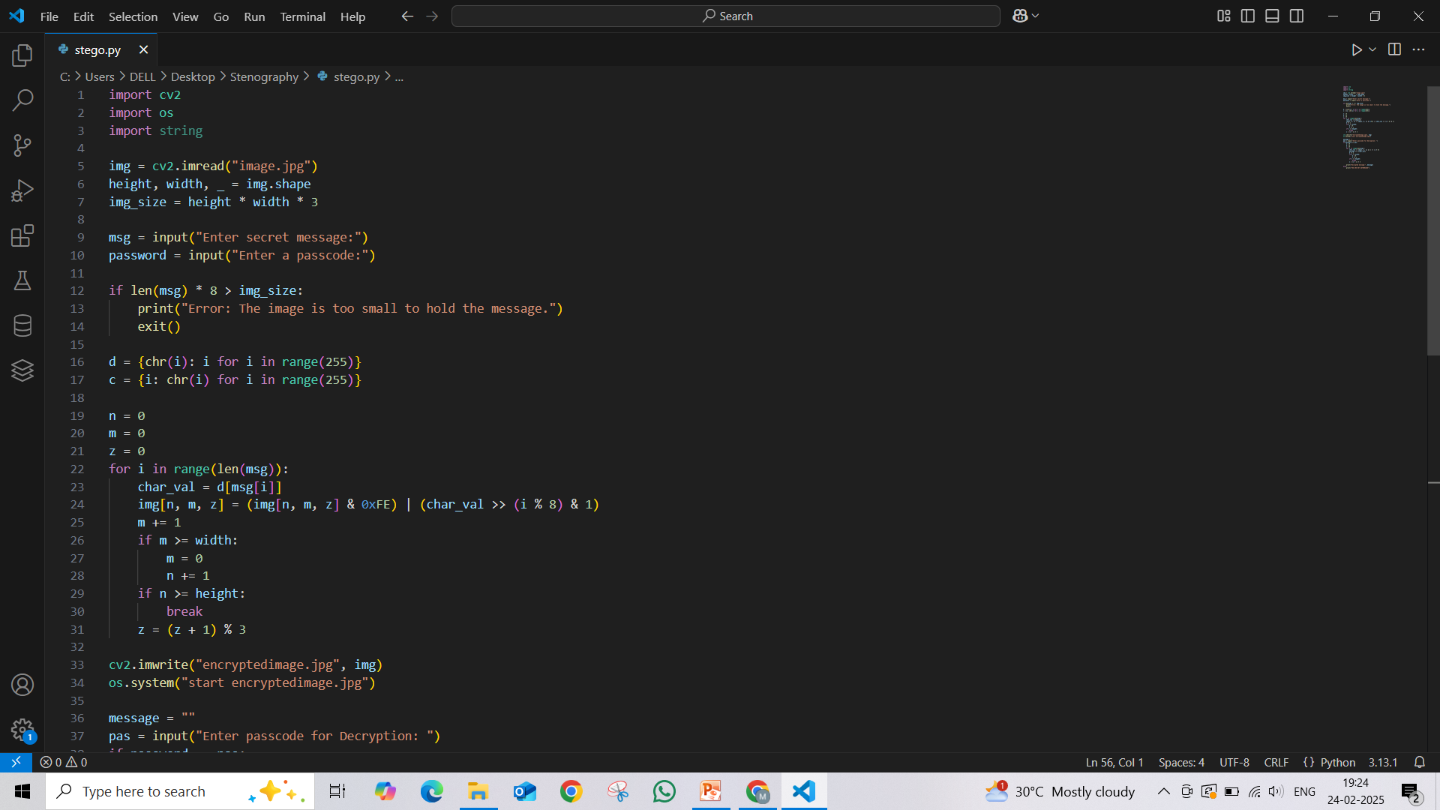
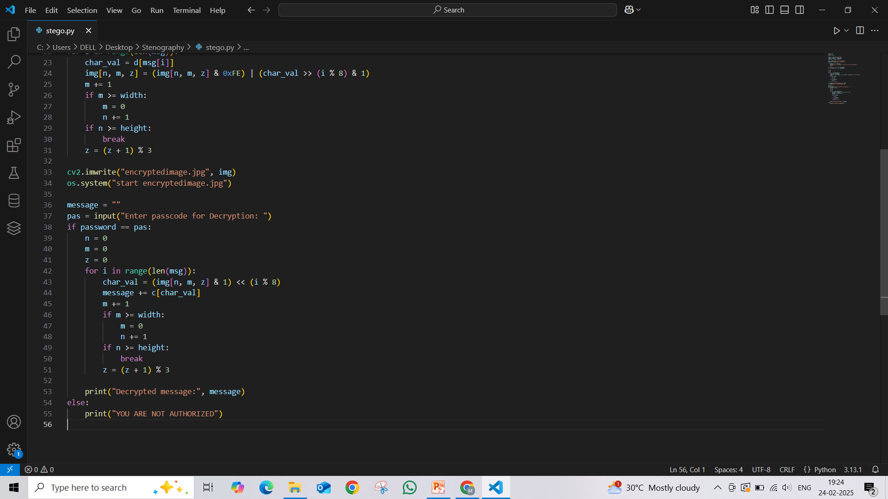

Results

Slide 8
GitHub Link
https://github.com/lavanyaduddukuri/cybersecurityaicte

Slide 9
Conclusion
In conclusion, this image stenography project effectively addresses the problem of securely hiding messages within digital images, ensuring that data remains discreet and protected from unauthorized access. By using bitwise encoding, password-based security, and interactive image manipulation, the project provides a simple yet secure method for embedding secret messages in images. The inclusion of checks for image size and real-time encoding/decoding ensures that the system is practical and user-friendly. Overall, the project successfully combines security, ease of use, and efficiency, fulfilling its objective to offer a reliable and private way to communicate hidden information.

Slide 10
Future scope(optional)
The future scope of this image stenography project includes:
Advanced Encryption Algorithms: Implementing more robust encryption methods, such as AES or RSA, in addition to the current password-based protection, to further secure the hidden messages.
Enhanced File Formats: Expanding support to include a wider range of image formats (e.g., PNG, BMP) and even other types of media files (e.g., audio, video) for more versatile data hiding.
AI and Machine Learning: Integrating machine learning algorithms to improve the accuracy and efficiency of the encoding/decoding process, and potentially adapt the technique for more dynamic environments.

Slide 11
THANK YOU

